Slide 1

Expand course12-Color track
Yahboom
Yahboom Omibox Tutorial

Slide 2
1
2
3
4
5
6
Learning
goals
Experimental
principle
Combine
blocks
Experimental
phenomena
Preparation
Search for
blocks
程序编程
Tencent
课前准备
Yahboom Omibox Tutorial

Slide 3
1
Preparation-1
1. The position of the Infrared sensor and color recognition sensor in the robot car
2. Learn to understand the principle of tracking
3. Learn how to combine color recognition with infrared tracking graphical programming blocks
Yahboom Omibox Tutorial

Slide 4
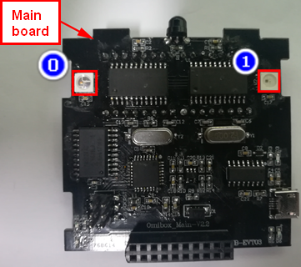
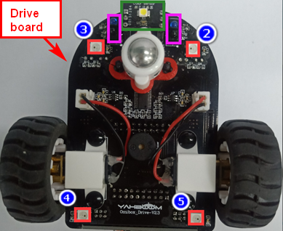
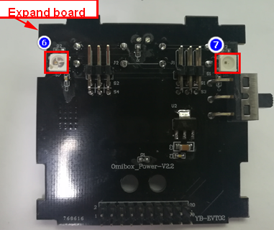
1
Preparation-2
As shown in the above picture, we circled the Infrared avoid sensor with two red wire frame, we circled the tracking sensor with two violet wire frame, we circled the color recognition sensor with a green wire frame. We can control them by programming.
Yahboom Omibox Tutorial

Slide 5
2
Learning goals
In this lesson we learn how to make Omibox tracking, while the color recognition sensor detects the color of the track and displays it through the colorful lights.
Yahboom Omibox Tutorial

Slide 6
3
Experimental principle
The basic principle of the tracking sensor is to use the reflective nature of the object. Our experiment is to tracking the black line. When the infrared light is emitted to the black line, it will be absorbed by the black line. When the infrared light is emitted to the other color line, it will reflected to the infrared receiver tube.
When the tracking module of the robot car detects a black line, the indicator light is off, and the indicator light is on when a white (no black) object is detected. We write the corresponding code to complete the tracking function according to this point.
Yahboom Omibox Tutorial

Slide 7
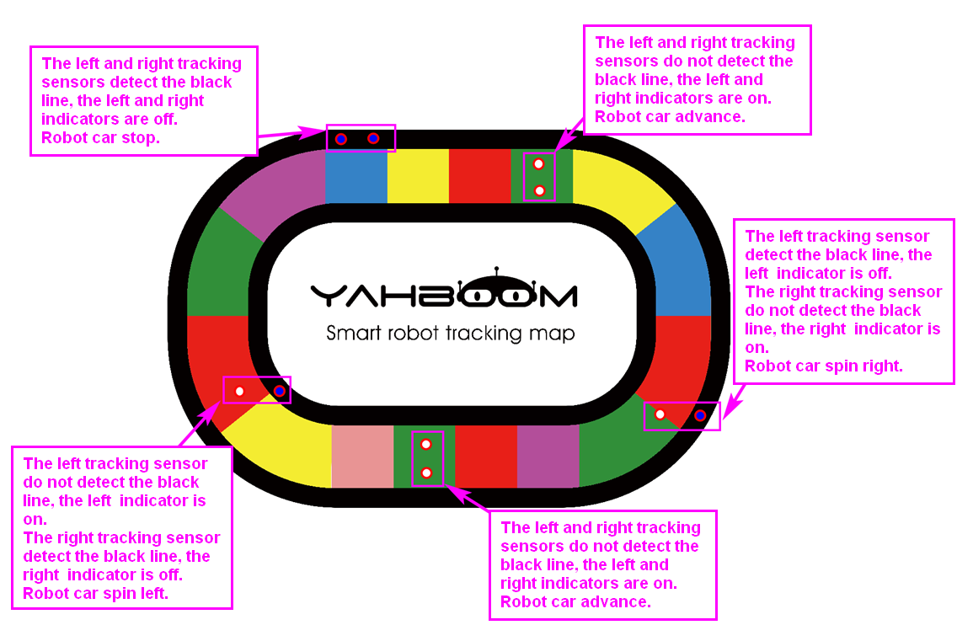
3
Experimental principle
Yahboom Omibox Tutorial

Slide 8
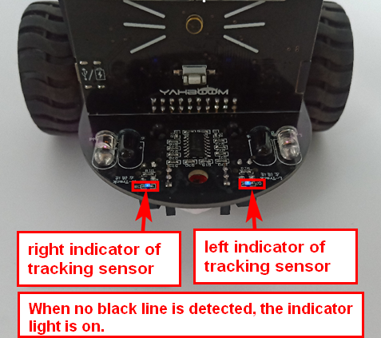
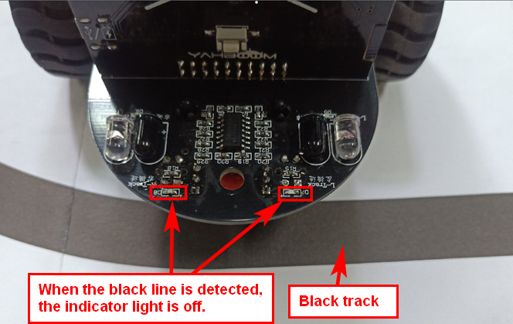
3
Experimental principle
Yahboom Omibox Tutorial

Slide 9
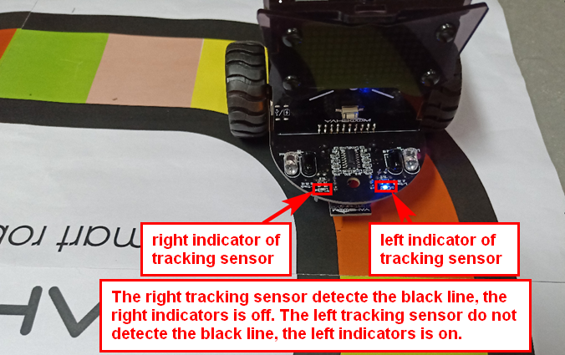
3
Experimental principle
For the tracking sensor, except for black, other colors of the material cannot absorb the infrared light emitted by the infrared emission tube, so when the tracking probe detects the color track, it is equivalent to recognizing the white color. Tracking experiments can be completed.
Yahboom Omibox Tutorial

Slide 10
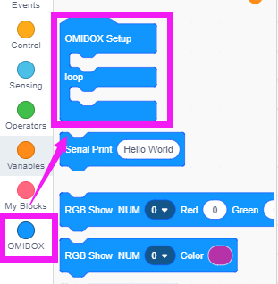
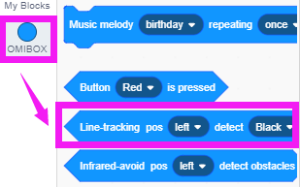
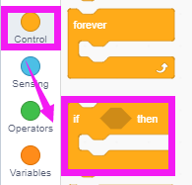
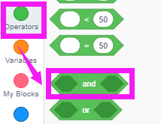
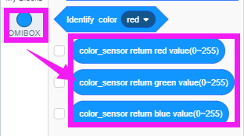
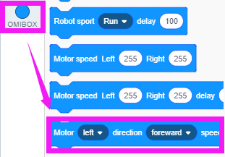
4
Search for blocks
The following is the location of the building blocks required for this programming.
亚博智能 OMIBOX视频教程

Slide 11
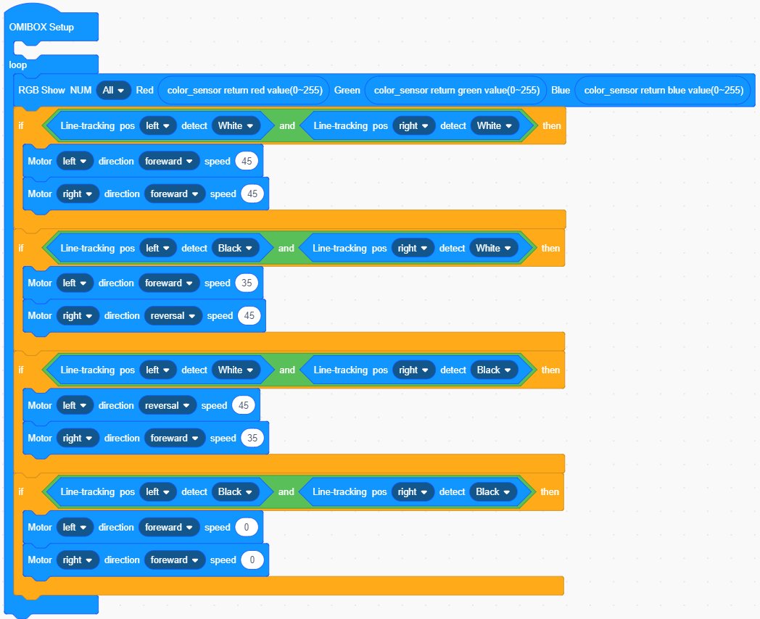
5
Combine blocks
The summary program is shown below:
Yahboom Omibox Tutorial

Slide 12
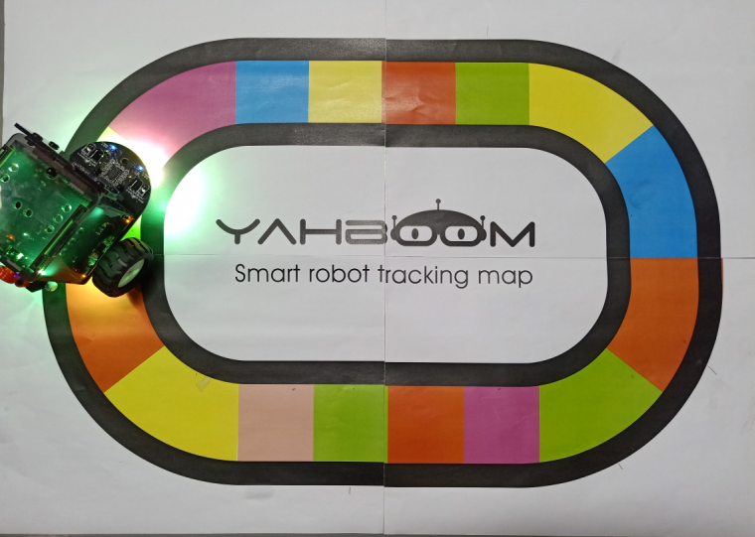
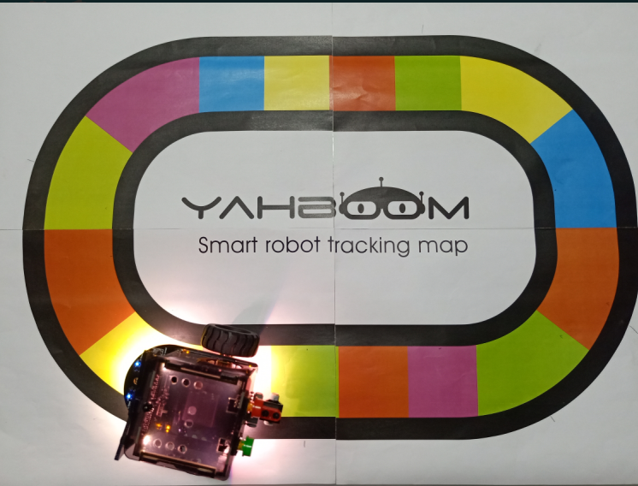

6
Experimental phenomena
After the program is uploaded, turn on the power of the robot, we can see that the car will travel along the color track, and the color of the colorful lights will change according to the color of the color track.
In order to avoid the interference of sunlight on the infrared light, the experiment must be carried out indoors.
Yahboom Omibox Tutorial

Slide 13
Inspire Creativity Embrace Innovation
Thank you!!!
Yahboom

